Slide 1

Buying With Impact: Social Enterprise Procurement Playbook
Social Procurement Seminar (Generic)

Slide 2

Introduction to Buying with Impact
Purchasing from Social Enterprises
Notes:
Introduce the initiative, give some context about the project.
Below is an adapted overview of the Buying with Impact Project.
The aim of social procurement is to change procurement from being a simple business transaction driven by the lowest price option to a powerful instrument that creates social value. Within the context of social procurement, social enterprises represent one of the main mechanisms by which organizations can achieve their social procurement objectives, because social enterprises are specialized in adding social value to their commercial activities. Social enterprise procurement can be seen as a specialized form of social procurement, and is defined as leveraging purchasing power to create social, environmental, and economic value in local communities, through buying goods and services from social enterprises.
In this seminar, we will elaborate on the concept of social enterprise procurement and how to foster social enterprise procurement within the context of your institution. Your institution plays an important role in the development and integration of social enterprise procurement practices.
Social enterprise procurement has been identified as a lever for increasing impact from institutions on their local communities, because supporting social enterprises aligns well with the social mission and mandate of various institutions. Social enterprise procurement does not only pertain to large acquisitions, but probably even more so to the smaller more repetitive purchasing decisions universities all make every day. However, buying from social enterprises and adopting existing procurement processes to the needs of social enterprises is not easy. Therefore, the Buying With Impact (BWI) project was established to explore the options of social enterprise procurement in Toronto and the Greater Toronto Area and to provide this seminar for purchasers. The BWI project complements previous initiatives on social enterprise procurement. We build on the insights from Buying Social Canada, AnchorTO, the Procurement and Investment Readiness Fund (PIRF) for social enterprises, and the B Corporation initiative.

Slide 3
Session Overview
Current state of procurement
What are social enterprises and why are they important?
How can you purchase from social enterprises?
How will you know you made an impact?
Feedback: tell us what you think of the seminar?
By the end of this session you will:
Gain an understanding of social enterprises
Know what businesses are social enterprises in Ontario and what you can purchase from them
Understand why purchasing from social enterprises is impactful
Learn how to purchase from social enterprises
Know how to track your positive impact from purchases
Notes:
Walk seminar participants through the agenda and objectives of the session.
Consider saying something like:
We have five major topics we will cover in this seminar and five learning goals.
Before we go into our first item lets discuss impact in general.

Slide 4

Sustainable Development Goals
17 goals, 169 targets and 230 indicators
A global framework and shared blueprint for peace and prosperity, for people and the planet, now and into the future.
Urgent call for action by all countries in a global partnership that recognizes that ending poverty must go hand-in-hand with strategies that improve health and education, reduce inequality, and spur economic growth – all while tackling climate change.
Notes:
Introduce the Sustainable Development Goals.
Consider saying something like:
When we think of impact its generally thought of through the lens of the triple bottom line planet, people and profit. The UN sustainable development goals break that down into 17 goals with over 230 indicators.

Slide 5
Can you think of ways your work aligns with the SDGs?
Brainstorm individually
(5 min)
Share with a partner
(5 min)
Room share back
(5 min)
Notes:
Walk participants through this quick activity. The objective of this activity is to encourage staff to connect their work with broader impact.

Slide 6




Impact Pillars at [Your Institution]
Climate Change Action
Leveraging Location
Presidential Advisory Committee on the Environment, Climate Change and Sustainability: Help support and integrate academic and operational sustainability
"Taking better advantage of our location in one of the world’s most vibrant, culturally diverse and economically dynamic regions, for the benefit of both the University and the residents of the Greater Toronto Area"
  Reduce GHG emissions by 37 per cent from 1990 levels by the year 2030
Improve the state of our host city-region
  Over 60% of Food Services’ food purchases under its direct control have been grown, raised or produced in Ontario.
Notes:
Validate the responses from participants in the previous exercise and transition into what the university has identified as impact.

Slide 7
Procurement at [Your Institution]
$
spent through procurement calendar year 2018
#
of invoices
#
of suppliers
Our personal spending habits have an impact.
Institutional purchasing habits can have a larger impact.
Notes:
Insert your procurement numbers here and speak to them.

Slide 8
How can we generate a greater impact with our purchases?
Purchasing from social enterprises can generate positive environmental impact as well as support the local community and economy.
Notes:
Read this slide

Slide 9

SEs: A Large and Growing Market in Canada
10,000
6,200
$12
$3.5
SOCIAL
ENTERPRISES
SOCIAL
ENTERPRISES
BILLION
BILLION
operating in Ontario
operating in Québec
Canadian cleantech industry
Organic food market in Canada
$4.3 billion in annual revenues
employing 50,000 Canadians in 800 firms
2015 Canadian Clean Technology Industry Report. Analytica Advisors (2015).
The National Organic Food Market. Canada Organic Trade Association (2013)
10
Notes:
Give participants an overview of this slide.

Slide 10
Social Enterprise: Ontario’s Definition
Earns Revenue | Derives a substantial portion of its income through the sale of goods and services.
Intentionality | Intends to create a social or environmental impact through its business activities. Impact is intentional and not merely a by-product of business operations.
Measurable | Measures and reports on its social, cultural and/or environmental impact.
Scalable Impact | A blended business model, with social impact as a defining element of its business model. The social and/or environmental impact of the social enterprise grows in lockstep with its business growth.
Active | An SE goes over and beyond the focus of operating in a sustainable manner, to seeking to actively contribute to solving a key social, environmental or cultural societal issue (the social enterprise’s social, environment and/or cultural mission and the social enterprise’s primary focus) through the use of a business model which permits the social enterprise to generate revenue for the sake of expanding the impact of its social, environment and/or cultural mission.
Adapted from Ontario’s Social Enterprise Strategy 2016-2021, https://www.ontario.ca/page/ontarios-social-enterprise-strategy-2016-2021
Notes:
Give participants an overview of this slide:
Consider saying something like:
We’ve defined social enterprises to align with Ontario’s definition.

Slide 11
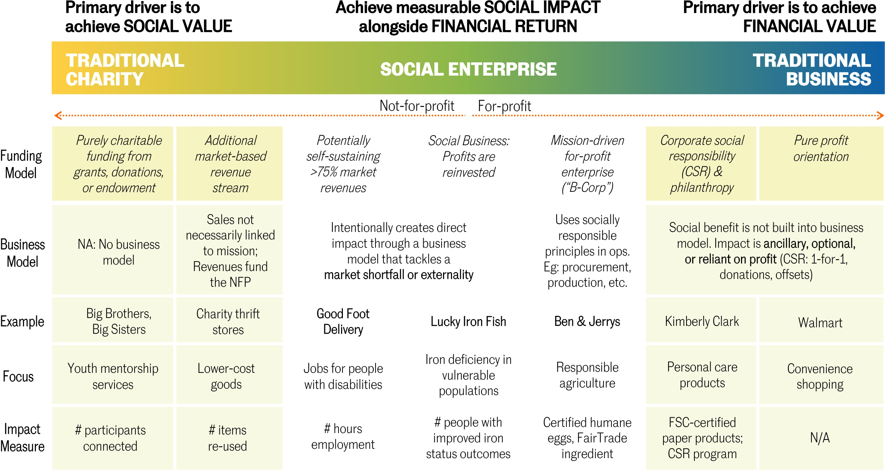
Notes:
Highlight the different between charities, social enterprises and businesses. Be sure to include the examples like Big Brothers Big Sisters, Good Foot Delivery, Ben and Jerry’s and Walmart.
Consider saying something like:
Another way to put it is social enterprises are part of a continuum where on the one side are charities and on the other are traditional businesses. For the purposes of aligning to the universities impact goals, we are focusing on social enterprises.

Slide 12




Defining Impact Certifications
B Corporation - Meeting the highest standards of verified social and environmental performance, public transparency, and legal accountability to balance profit and purpose.
Buy Social - Recognizing verified social enterprises actively prioritize community benefits and social impact over private profit and shareholder returns.
Fair Trade - Supporting better prices, decent working conditions, fair terms of trade for farmers and workers, and protecting the environment in which they live and work.
Canada Organic - Ensuring the integrity of organic products from field to table: a minimum benchmark that determines the basic requirements for organic food production systems.
Notes:
Walk participants through the various impact certifications:
Consider saying something like:
Social enterprises use various certifications to provide credibility of their purpose and impact. Some common certifications are included here.

Slide 13





Procurement at [Your Institution]
Climate Change Action
Leveraging Location
Harmony Organic - supporting sustainable agriculture, helping to prevent further land, water and air pollution.
VG Meats - local, never fed antibiotics, no added hormone, beef.
Good Foot Delivery - A delivery service employing people with developmental disabilities, in Toronto, on foot and via public transit.
Reunion Island Coffee - beans sourced through direct trade partnerships or certified.
Green Republic - Reduces coffee waste by 95%, and repurpose the rest all while supporting our community.
Notes:
Add any social enterprises that your institutions currently procures from
Consider saying something like:
The good news is that departments are already purchasing from social enterprises

Slide 14
Social Enterprises
Brainstorm examples of social enterprises on your own.
Spend 5 minutes discussing your ideas with the person next to you.
Share back with the group.
Notes:
Encourage participants to focus on social enterprises that the university could purchase from rather than at a personal level.

Slide 15

Social Enterprise Example
Summary | Toronto’s 3rd largest bicycle courier firm. Delivers packages and food orders. TurnAround also provides last-mile services for other couriers.
 | Zero-to-low emissions delivery service # Carbon offset from bike delivery VS vehicle delivery
 | Decent work* for at-risk youth # of marginalized youth hired (referrals from shelters and agencies) Couriers have access to healthcare benefits and WSIB Couriers have access to finance for higher-ed
*Decent work as defined by the ILO http://www.ilo.org/global/topics/decent-work/lang--en/index.htm
Notes:
This is an example of a social enterprise in Toronto. Walk participants through their purpose and impact.

Slide 16

Social Enterprise Example
Summary | A program that transforms loyalty program points (i.e. Aeroplan) into payments for school tuition and student loans.
 | Available to all students, regardless of need or academic standing Serving marginalized students Promoting civic engagement
 | Access to an additional source of funding for student education $ Dollars offset # of students supported
Notes:
This is an example of a social enterprise in Toronto. Walk participants through their purpose and impact.

Slide 17
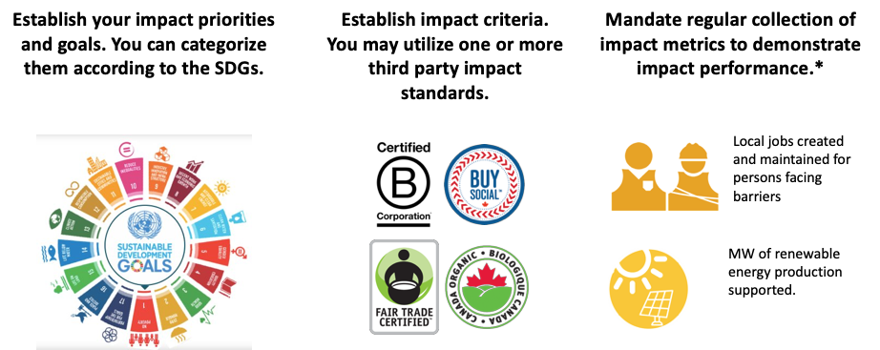
How We Manage Impact
Establish impact priorities and goals aligned to SDGs.
Establish impact criteria using one or more third party standards.
Regularly collect impact metrics to demonstrate impact performance.
*NB. Social enterprises often provide self-reported data.
Notes:
Walk participants through how the team intends to manage impact.

Slide 18



How We Will Report On Impact
Dollar spend toward Social Enterprises pursuing SDGs of choice (i.e. Climate Action, Decent Work, etc.)
Dollar spend toward Social Enterprises with Impact Certifications of choice (i.e. B-Corp, Fair Trade, Buy Social, etc.)
Impact metric data provided by social enterprises (i.e. self-reporting, third party reporting, etc.)
Notes:
Walk participants through how the team intends to report on impact.

Slide 19
Impact Example: Recycled Paper – Brazil, Bignardi Papéis
Summary
The Foundation for Education Development in Brazil procured recycled notebooks for middle and high-school kits from Bignardi Papéis, a pulp and paper company leading the sustainable paper industry in Brazil by offering Eco-certified products and tracking measurable decreases in water consumption.
The purchase of 3,792,015 notebooks (with 180 sheets per piece) made of 60% recycled paper fibers, allows savings of:
  8 829 m3 of water, which represent more than 8 million liters;
  1 766 tonnes of waste;
  241 kg of organo-halogen compounds.
It is estimated that the purchase of notebooks made with recycled paper provided a one month economic activity to 454 waste pickers.
Source: http://www.unep.fr/scp/procurement/docsres/projectinfo/studyonimpactsofspp.pdf
Notes:
Here is an example of what impact might look like after a purchase has been made and impact has been measured.

Slide 20
Impact Example: YORBuild Sustainable Construction – England, UK
Summary
YORbuild is a series of collaborative construction frameworks for the procurement of new build, refurbishment and design construction projects that link to themes of employment and skills, sustainability, economic regeneration and supply chain engagement.
Reduced waste to under 10 tonnes per £100k tranche of work
Recovered 70% of construction waste and 80% of demolition and excavation waste
15% of materials used to be recycled/reused
2,091 school pupils have attended construction site visits/workshops
286 people have progressed from training to employment
195 work experience placements have been provided
45 apprenticeships have been offered
Source: http://www.unep.fr/scp/procurement/docsres/projectinfo/studyonimpactsofspp.pdf
Notes:
Here is an example of what impact might look like after a purchase has been made and impact has been measured.

Slide 21
Impact Example: Laser Printer Toner Cartridges – France, APF Entreprises 34
French Ministry of Education procured toner cartridges from APF Entreprises 34 – The French Association of Paralysed People), an organization based in the French department of Hérault and dedicated to the support of disabled and paralyzed people.
Summary
Estimated that 7 452 kg of waste have been saved from January 2009 to June 2011.
Full-time jobs to 7 disabled persons in 2009 and to 9 disabled persons in both 2010 and 2011.
Source: http://www.unep.fr/scp/procurement/docsres/projectinfo/studyonimpactsofspp.pdf

Slide 22
Purchasing from SEs at Anchor Institutions
What purchasers said:
Make it easier to find social enterprises
Make the process convenient and quick
Track impact to institutional and societal impact
Be recognized for impact
Notes:
Consider saying something like:
Through interviews with purchasers as part of the project, they said…

Slide 23
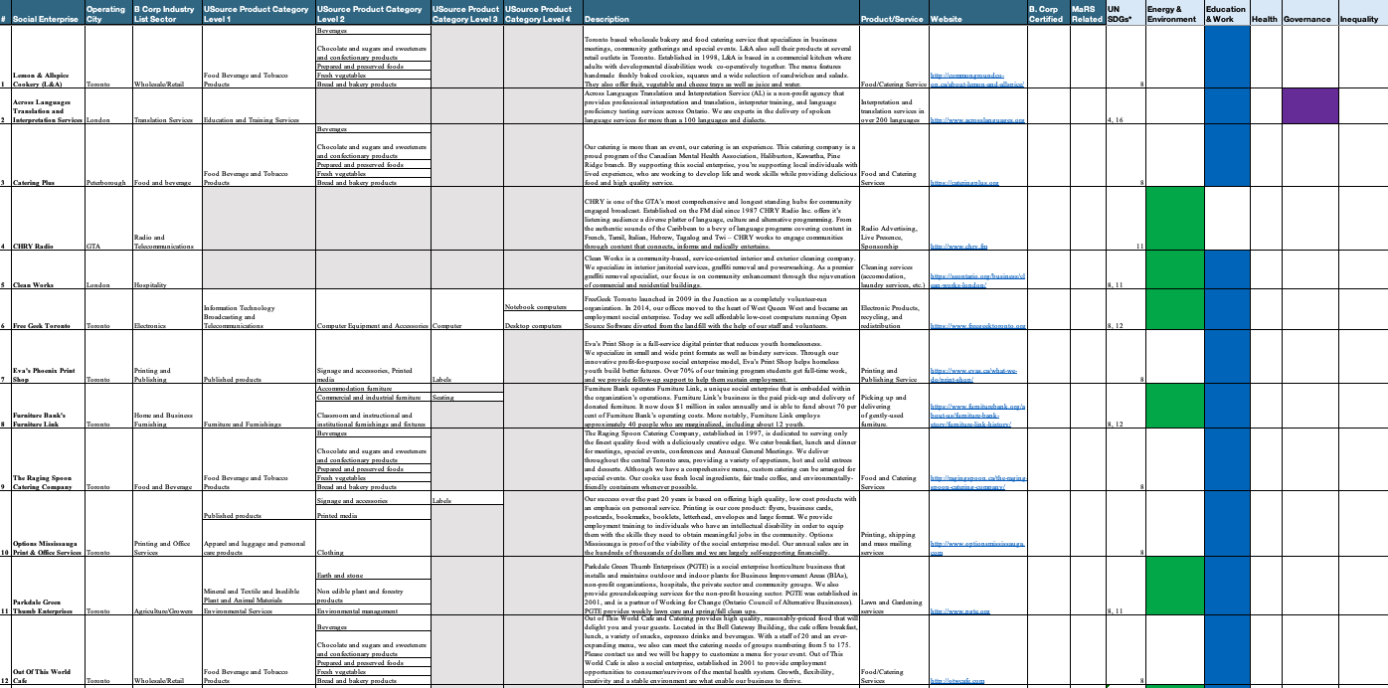
Where Can You Find Social Enterprises?
Internal Social Enterprise List
Includes 57 Social Enterprises in the GTA
Aligned to product categories and Sustainable Development Goals
Notes:
Consider saying something like:
To make it easier to find social enterprises you can use our internal list.
Include information about where this list is housed and who is responsible for owning and maintaining it

Slide 24





Where Can You Find Impact Businesses?
In addition to the list we curated, the following directories are all good sources.
SEontario Directory | https://seontario.org/directory/
B Lab Canada Directory | https://bcorporation.net/about-b-lab/country-partner/canada
Fair Trade Directory | http://guide.fairtrade.ca/
Toronto Enterprise Fund Portfolio | http://www.torontoenterprisefund.ca/what-we-do/sustain-existing-eses/who-we-fund
Indigenous Business Directory | http://www.ic.gc.ca/eic/site/ccc_bt-rec_ec.nsf/eng/h_00011.html
Notes:
Consider saying something like:
In addition to the list, here are some directories that are also good resources for sourcing businesses with an impact focus.

Slide 25
How to Purchase from SEs?
Under 5k
Purchase directly from a social enterprise using your p-card
Above 5k but under 25k
Include one quote out of two from a social enterprise in a purchase order
Above 25k but under 100k
Include one quote out of three from a social enterprise in a purchase order
Notes:
Walk participants through your institution’s purchasing process.
Consider mentioning how impact will be tracked.

Slide 26
Questions?

Slide 27
Feedback on Seminar
How likely are you to recommend this seminar to a colleague?
Very unlikely 0,1,2,3,4,5,6,7,8,9,10 Very Likely
If you could change something about this seminar what would it be?
Describe the highlights of the seminar.
Would you be willing to allow us to add your highlight comments to the seminar website?
Notes:
Print these questions out in a handout that you can ask participants to fill in before they leave. The feedback captured from this seminar can be used to continuously improve the delivery of the content. The first question is asked to calculate a Net Promoter Score (NPS). More information on NPS can be found here: https://www.netpromoter.com/know/

Slide 28



