Slide 1

Innovation Partnership: Procurement by Co-Design Toolkit
User Personas Templates

Slide 2
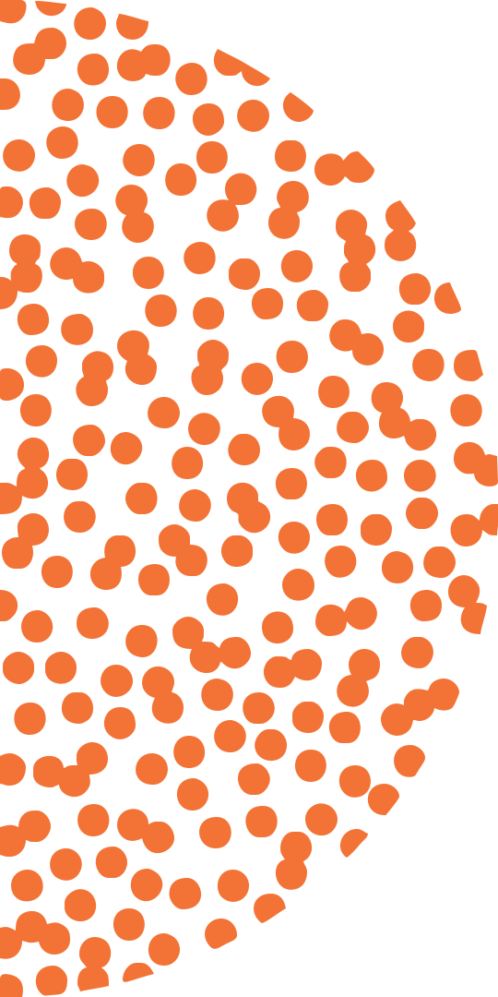
Instructions

Slide 3
Synthesizing Insights
By engaging users you’ve collected a lot of data, generated important insights
To make them useful for the next phase of ideation and prototyping, let’s synthesize key learnings into practical reference tools: User profiles
User profiles will make sure your users’ goals and their contexts drive the design and development of the solution
They also ensure a shared understanding among the co-design team and other beneficiaries and stakeholders

Slide 4
Create 3-5 User Profiles
  1 “Organizational profile” – a snapshot of your organizational context
  2 – 4 “End-user profile(s)” – this is only a guideline; actual number and segmentation will depend on your particular project and insights
  Ideally profiles are a composite of several (5 – 10) people you have engaged, and summarizes things those people have in common, as well as important variations
  End-user profiles may reflect two versions of a common user type (e.g., patients who have very different goals, behaviours and motivations)
  End-user profiles may reflect different user types (patient vs. physician)

Slide 5
Guidelines for what to include
    Name and title
    Visual – photo collage or drawings that include
      People
      Activities and environment, interactions
      Sample of relevant documents or reference sources
      Any ’key considerations’ (see below)
    Quote that summarizes main goal (what they are trying to achieve)
    5-10 key considerations for helping them achieve their goals, e.g.,
      What they find the most rewarding
      Pain points
      Important processes
      Constraints
      Values
    Note: do not include demographic details unless your user engagement specifically suggests some particular aspect is a key consideration

Slide 6
Content Based on Insights
  Use the examples as a template for formatting and scope; however, use the data from your user engagement work to create profiles that highlight and summarize your team’s understanding of end-users to date
The visuals should ideally come from photos you have taken as part of your site visits and field studies
If not possible to take actual photos, you could
  Take a photo and edit out any sensitive information
  Use similar or analogous photos from Google images
  Create a drawing by tracing a photo
If you are still collecting data for the discovery phase, base these profiles on your key insights to date (current understanding)

Slide 7
Examples

Slide 8
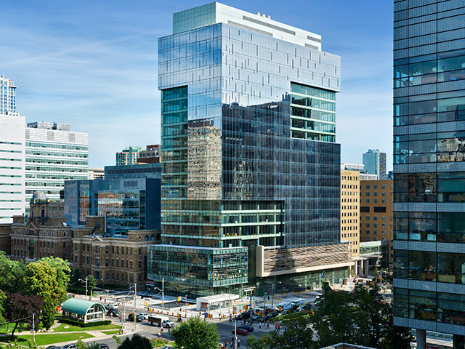
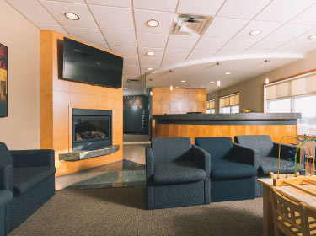

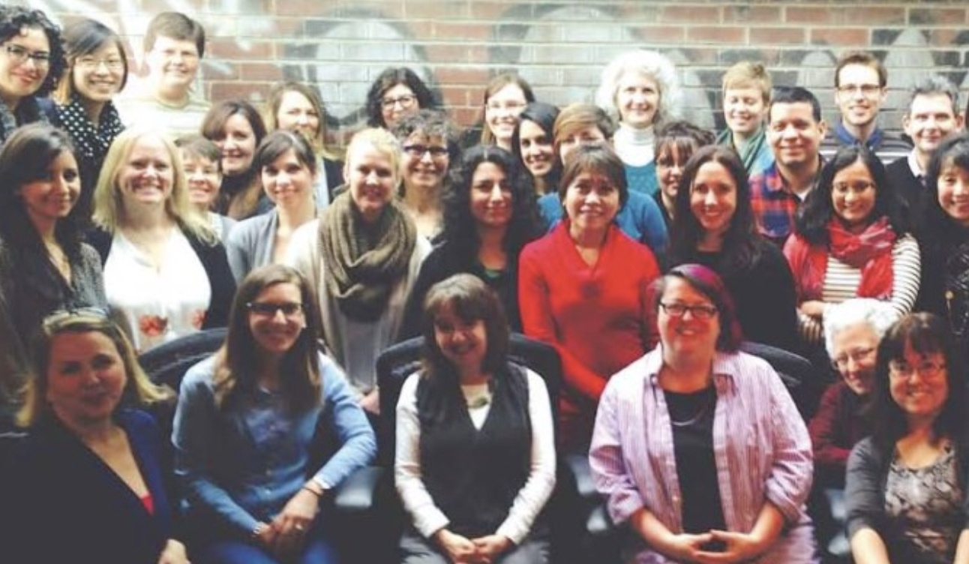
MaRS Family Health Clinic
Organizational Context
Family health team with 15 family physicians and 20 interdisciplinary health care providers (including nurse practitioners, dietitians, social workers, pharmacist, registered nurses and physician assistant)
Main College and University location with a satellite office at Eglinton and Yonge
Focus on health promotion, disease prevention and chronic disease management (diabetes, COPD, Hypertension).
Funding model based on number of enrolled patients and outcome-based bonuses.
Serve approximately 8,000 patients in Toronto and surrounding area.
  100 patients at risk of hypertension.
  Past year, only 2% managed with diet; rest went on to develop hypertension and required medication.

Slide 9
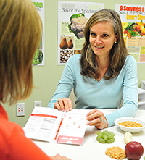
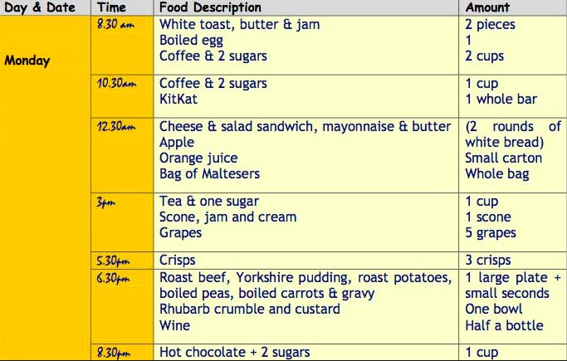
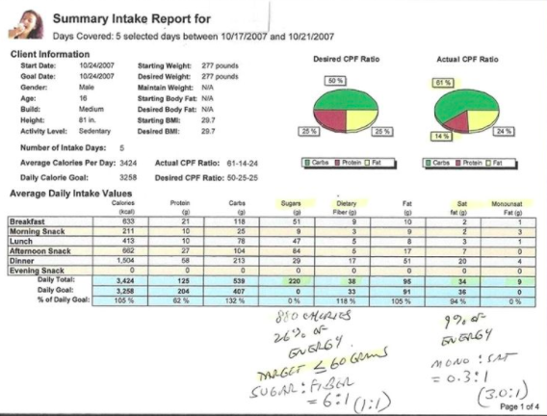
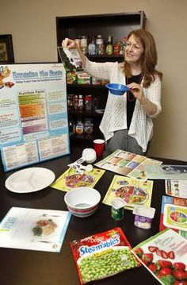
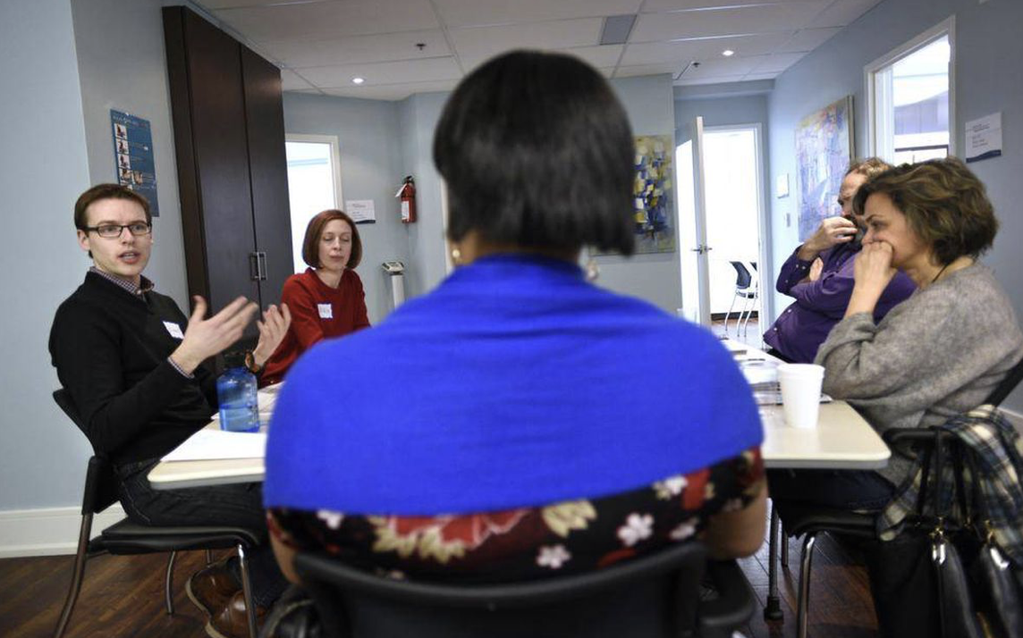
Dietician
“When I’m meeting with clients, I want to provide personalized plans so that they can reduce symptoms, prevent disease and manage their health through nutrition.”
Nora
Key Considerations
Most rewarding: seeing the nutrition therapy succeed – e.g., patient with diabetes is happy and controlling their blood sugar
Interventions should be based on evidence-base and data
Being efficient means making sure client brings information I need to help them (e.g. food diary, test results, etc.)
Finds it challenging to complete initial client education within funded consultation time
Meets with 5 – 8 clients a day, 10 – 20 min. sessions each
Mainly works at College clinic but sometimes sees clients at satellite location
Participates in weekly clinical staff meetings to discuss cases
Overall process with each client: assess, educate, set goals, deliver nutritional intervention including behavioural change techniques, monitor outcomes, report back to clinical team

Slide 10
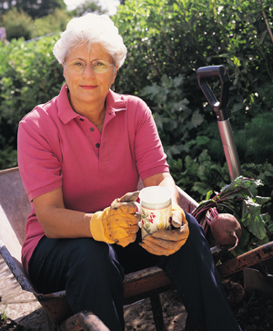
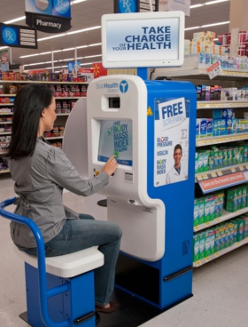


Client
“When I meet with the dietician, I want to know if what I’m doing is helping my condition get better or doesn’t get any worse.”
Annie
Key Considerations
At risk of developing a chronic condition: has high blood pressure but not yet diagnosed with hypertension by her physician
Seeing a dietician to help manage condition so that she doesn’t have to take medication
Finds it challenging to remember and record her meals in the way that the dietician always asks for (specific amounts by type) , often makes guesses for a few items
Worried that changes to her diet will get in the way of enjoying get-togethers with family and friends
Checks her blood pressure at the local pharmacy once a month or so
Trying to make a habit of taking a 10 min. walk after each meal
Feels unsure if her food choices are making a difference or not

Slide 11



